Slide 1
Fragmented Architectures
Patterns with smaller components

Slide 2
Contents
Several patterns don’t rely on system-wide layers:
Layered Services – divide into services, then into layers.
Polyglot Persistence – employ multiple databases.
Backends for Frontends (BFF) – dedicate a service to each kind of client.
Service-Oriented Architecture (SOA) – divide into layers, then into services.
Hierarchy – recursive subdivision.

Slide 3
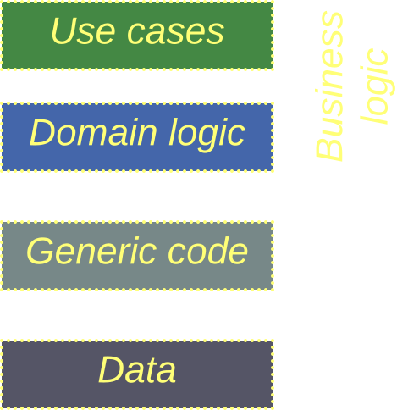
Schema
Some of the patterns we’ll cover define the primary architecture of the system.
Others extend a basic architecture, such as subdomain Services or Layers.
The components are color-coded

Slide 4
Layered Services
Each service is made of layers

Slide 5
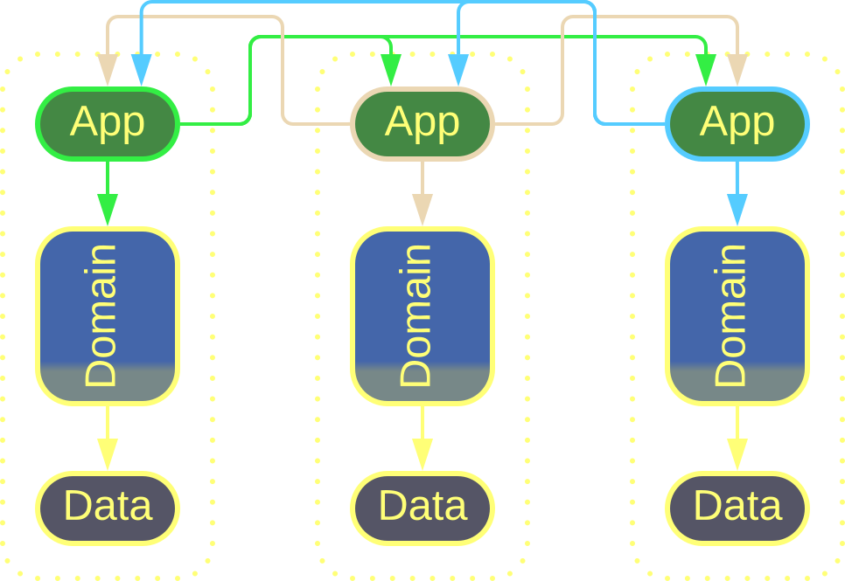
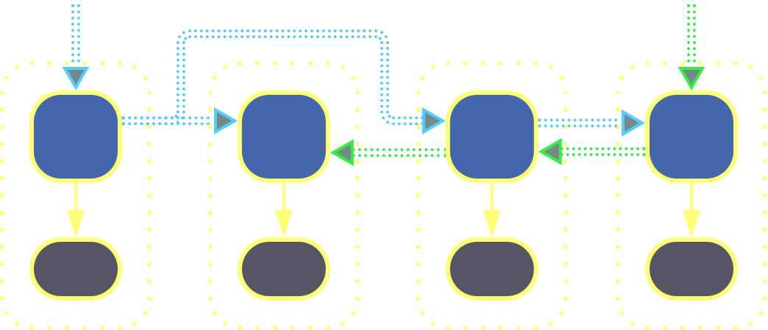
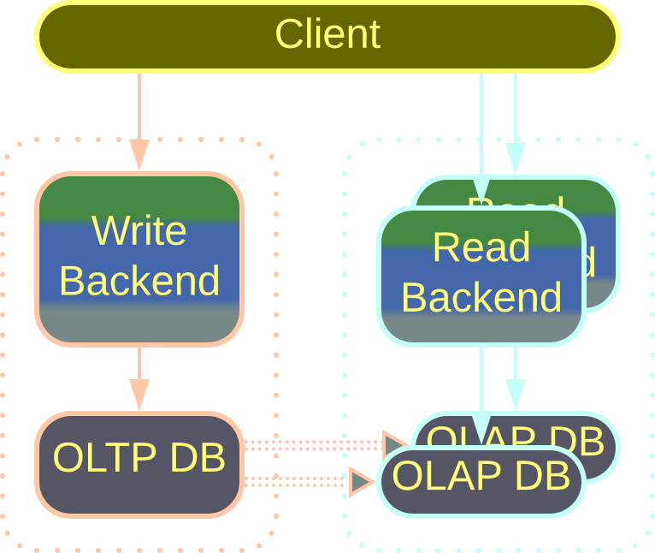
Layered Services – overview
Layered Services may intercommunicate at different levels:
Orchestrated 3-Layered Services | Choreographed 2-Layered Services | Command-Query Responsibility Segregation

Slide 6
Layered Services – variants
The most common orchestrated architecture is 3-Layered Services. Each service contains application, domain rules, and infrastructure layers.
The application-level components may call each other, linking the services into a coherent whole.
Other layers remain isolated within their services.
Orchestrated 3-Layered Services
Layering isolates interservice dependencies.
But it takes certain effort to implement and maintain.

Slide 7
Layered Services – variants
A choreographed system has no application layer. The use cases are encoded in the connections between the services which make a Pipeline.
In 2-Layered Services each service stores its data in a private database for the sake of encapsulation.
Choreographed 2-Layered Services
Private databases make the services almost perfectly independent.
But they add to operational complexity.

Slide 8
Layered Services – variants
When one service handles all write requests (commands) while another one is dedicated to reading (queries), that’s Command-Query Responsibility Segregation (CQRS).
The command and query services may have separate databases (OLTP and OLAP, respectively) and the query service may scale independently.
CQRS
CQRS may simplify both commands and queries.
But in many cases it may be an overkill or a wrong abstraction.

Slide 9
Polyglot Persistence
Multiple storages

Slide 10
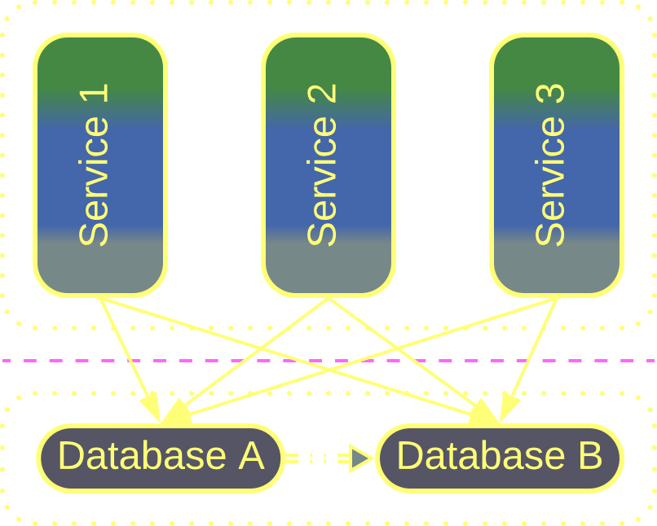
Polyglot Persistence – overview
You can rely on dedicated storage technologies for different kinds of data or patterns of data access in your system.
The storages may be independent or one may derive its data from another. They may be private to a service or shared within the system.
Polyglot Persistence
Polyglot Persistence is found in high-load or low latency systems.
It may be too complicated and fragile for general use.

Slide 11
Polyglot Persistence – trade-offs
Performance is fine-tuned for multiple access patterns
The load is distributed among the datastores in use
Multiple technologies need to be mastered
There is more operational complexity and more points of failure
Data consistency becomes an issue

Slide 12
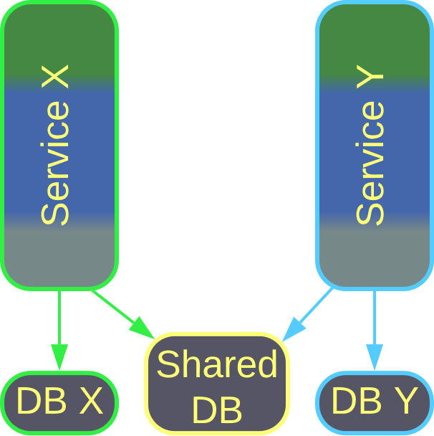
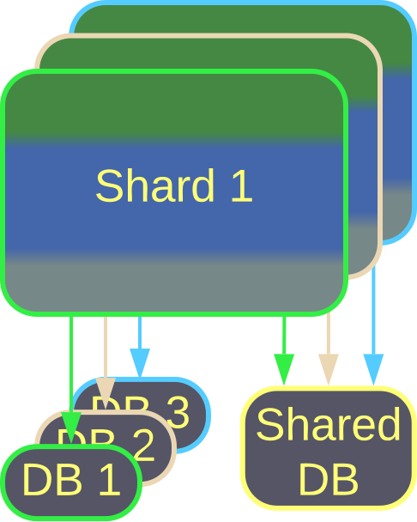
Polyglot Persistence – independent DBs
If Shards or Services become coupled through a small subset of the system’s data, that subset can be extracted into a Shared Database, while the main dataset remains private.
Private and Shared Databases for Services
Private and Shared Databases for Shards

Slide 13
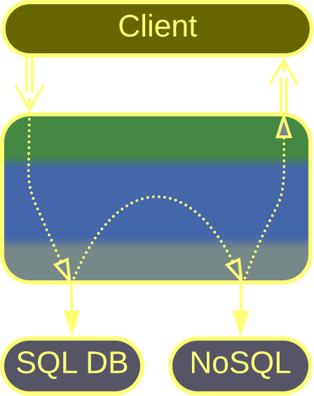
Polyglot Persistence – independent DBs
There are many database engine technologies, each optimized for a small number of use cases and data types.
If you need top-grade performance, you can hand-pick databases that best fit the structure and access patterns for subsets of of your data.
Specialized Databases

Slide 14
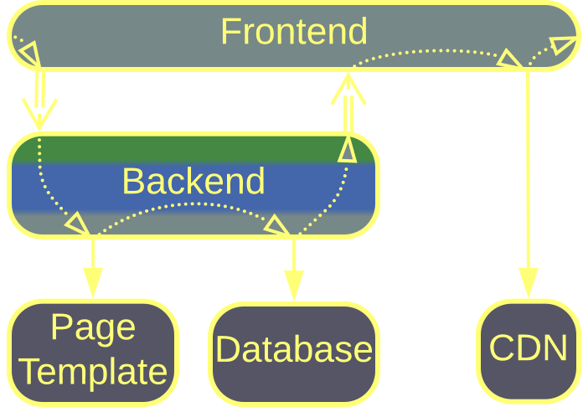
Polyglot Persistence – independent DBs
Some data types, such as web page templates, images, or videos, are best served from files.
A Content Delivery Network (CDN) is a distributed file storage that replicates web content over the globe so that every user downloads it from the nearest data center.
Data File and Content Delivery Network

Slide 15
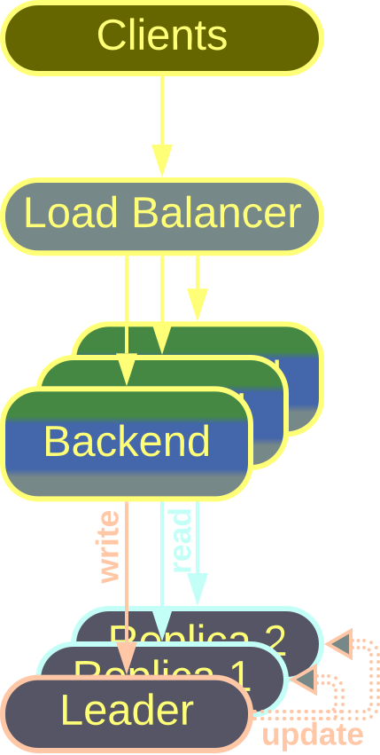
Polyglot Persistence – derived DBs
Read-heavy systems benefit from running multiple read-only replicas of the database.
One instance of the database, called leader, accepts all write requests and propagates changes to other replicas used in read-only queries.
If the leader becomes unavailable, any other replica is promoted to the leader role.
Read-Only Replicas

Slide 16
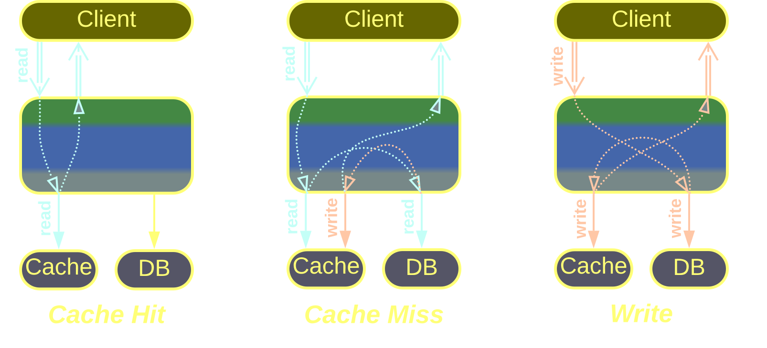
Polyglot Persistence – derived DBs
A Database Cache stores the most recent database queries and their results in memory to bypass the main database when a known query is repeated.
The hard part is keeping the data in the Cache and the database in sync.
Cache-Aside, Database Cache

Slide 17
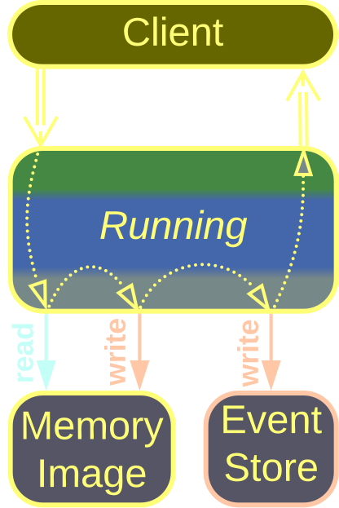
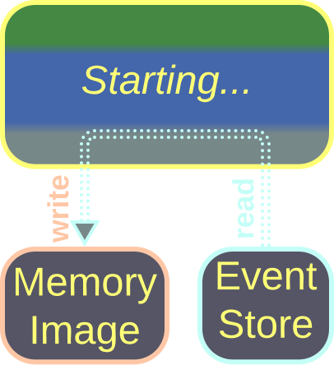
Polyglot Persistence – derived DBs
A Memory Image aggregates events into an up-to-date snapshot of the (sub-)system’s state.
It is queryable, unlike the event store.
Memory Image
– starting
Memory Image
– running

Slide 18
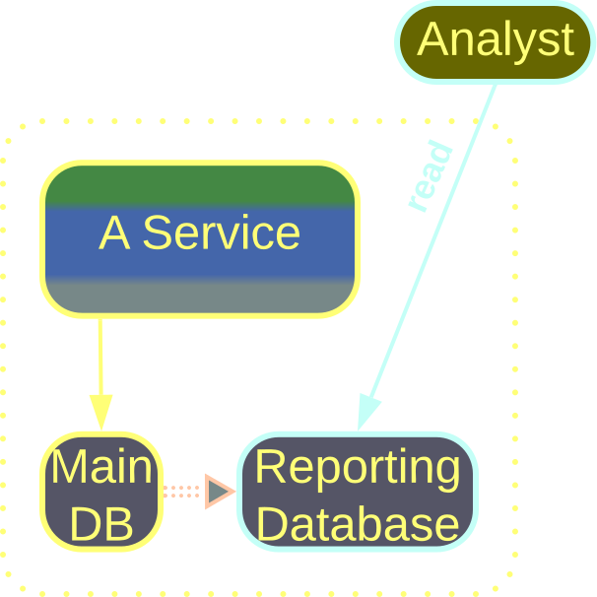
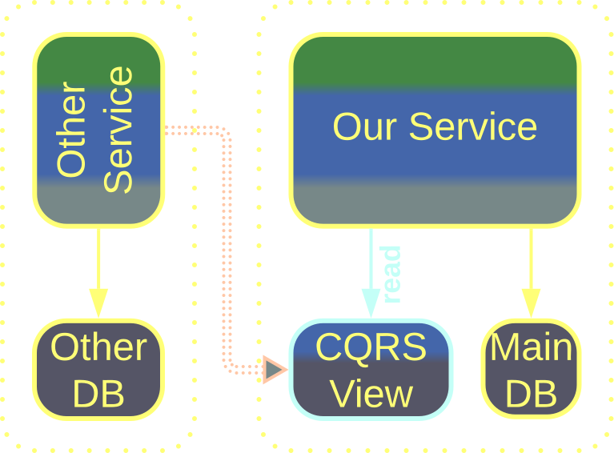
Polyglot Persistence – derived DBs
Here we have dedicated OLTP (commands) and OLAP (queries) databases.
A Reporting Database exposes the dataset of this service to external queries.
A CQRS View aggregates events from another service into a queryable state.
Reporting Database
CQRS View

Slide 19
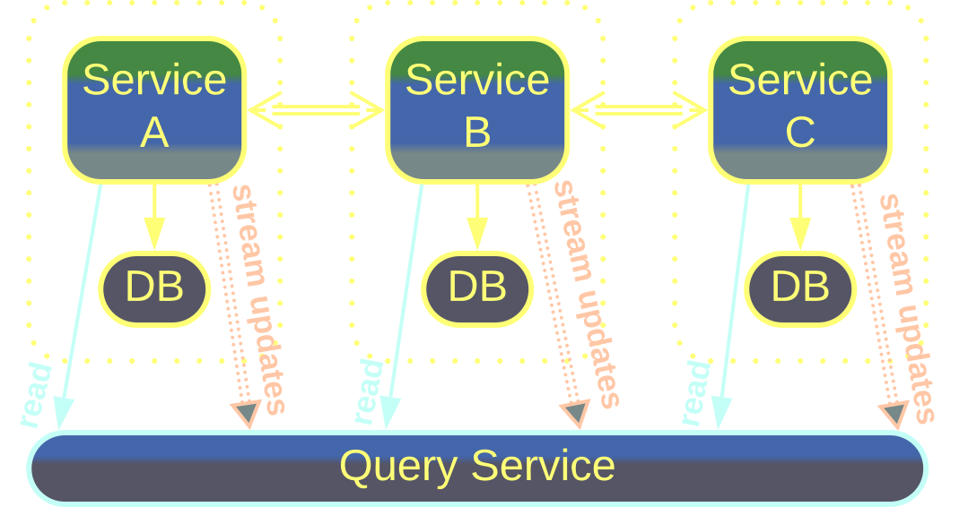
Polyglot Persistence – derived DBs
A Query Service is a shared CQRS View. It aggregates events from multiple services to provide a consistent, queryable representation of the state of the whole system.
Query Service

Slide 20
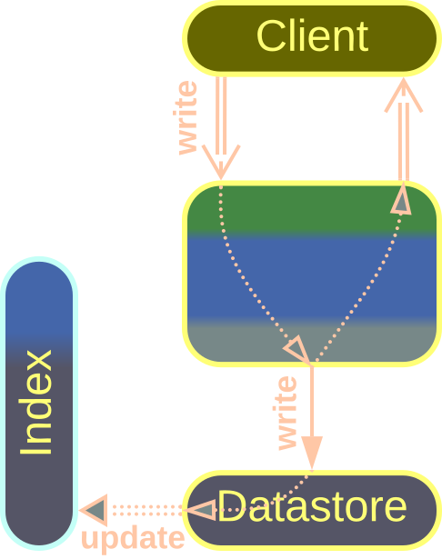
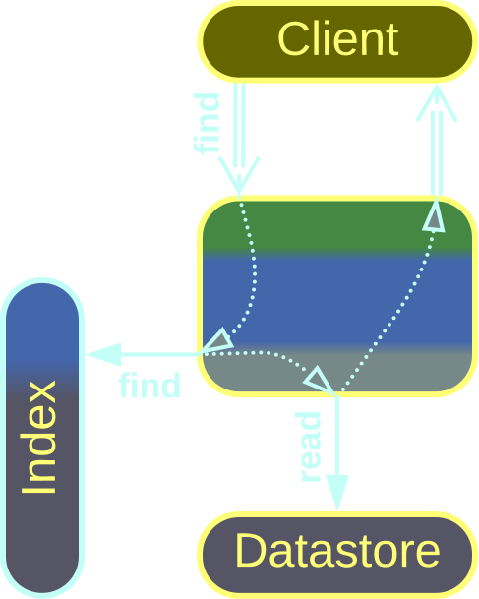
Polyglot Persistence – derived DBs
An External Index is a query engine dedicated to an uncommon technology, such as NLP or geospatial data.
You can use it to get a list of all the rows in your main database that match a special kind of query not supported by your primary database.
External Index
– update
External Index
– find

Slide 21
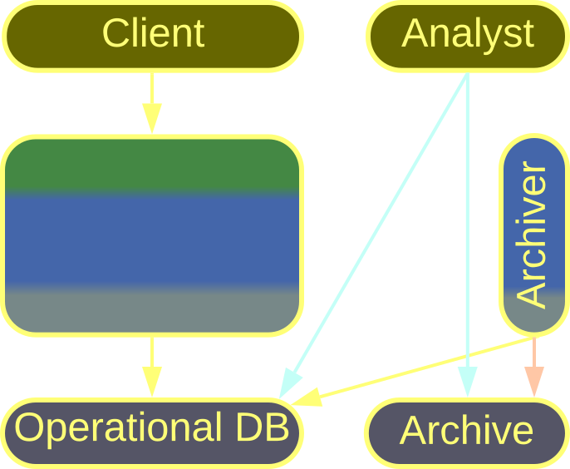
Polyglot Persistence – derived DBs
Keeping old data which is not going ever to change together with the most recent records bloats and slows down your main OLTP database.
Therefore you should periodically move the old data to a read-only archive OLAP storage.
Data Archiving

Slide 22
Backends for Frontends
Each kind of client gets a dedicated service

Slide 23
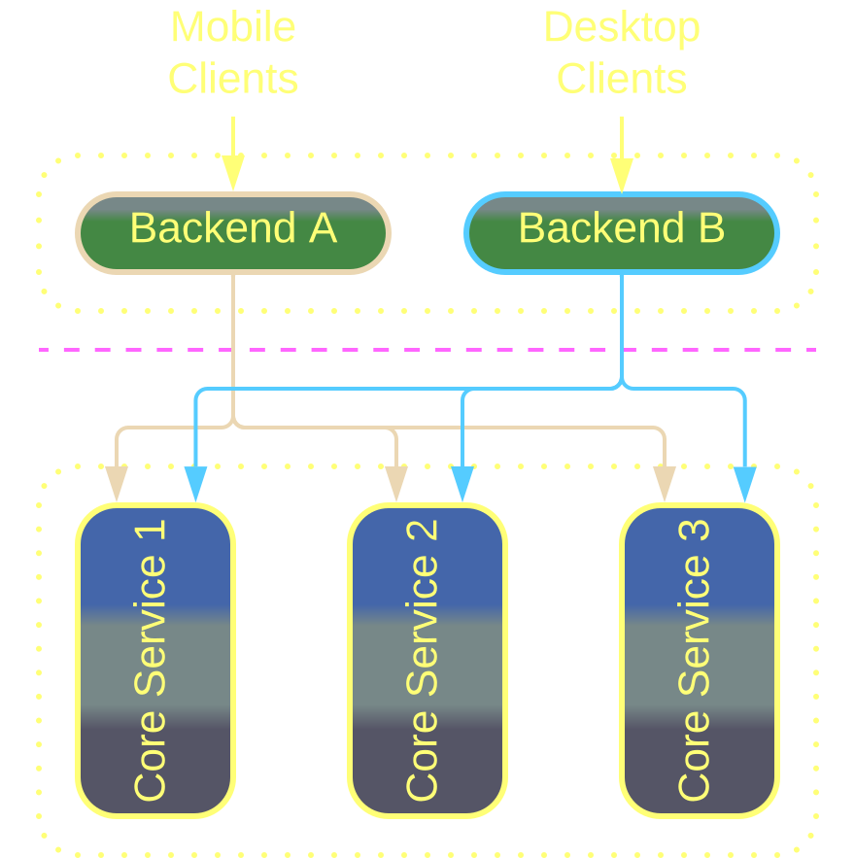
BFF – overview
If you clients differ in their protocols and/or workflows, you can dedicate a component (Backend for Frontend, BFF) to each kind of client.
The BFFs may act as Proxies, Orchestrators, or their combinations.
Backends for Frontends
BFF is useful with dissimilar client protocols, UIs or workflows.
Its use with closely related clients asks for trouble.

Slide 24
BFF – trade-offs
Clients and the teams that support them become independent
Each of the multiple BFFs tends to be much simpler than a universal layer
It’s hard to share code between BFFs
BFFs increase operational complexity

Slide 25
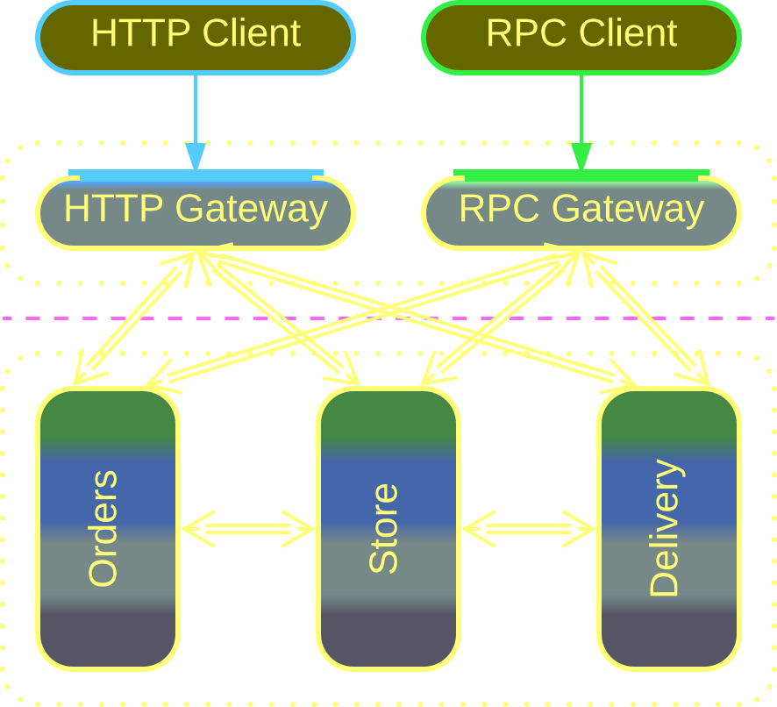
BFF – variants
Multiple Proxies are made use of to support clients that differ in their protocols but not workflows.
An example is accessing the system from the internal network and via a VPN.
Proxies are often available off the shelf and don’t require much effort to set up.
Proxies

Slide 26
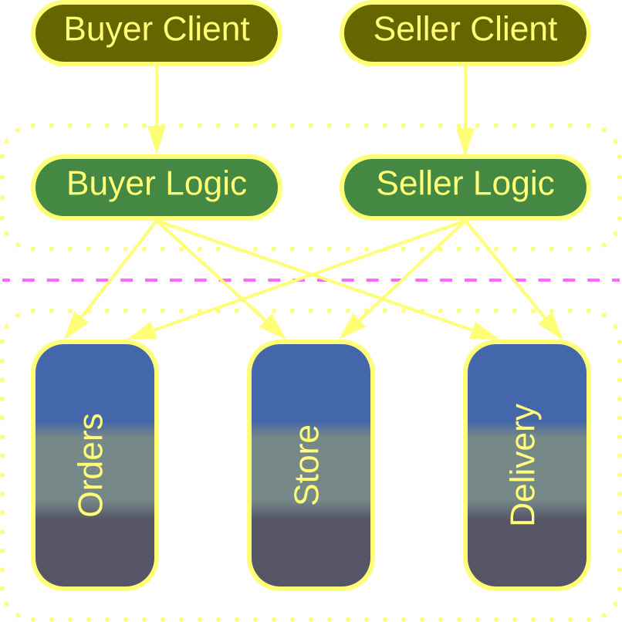
BFF – variants
BFF Orchestrators deal with workflows but not protocols.
For example, an online store may use different Orchestrators for buyers and sellers.
Each Orchestrator is likely to remain relatively small and simple thanks to the separation of concerns.
Orchestrators

Slide 27
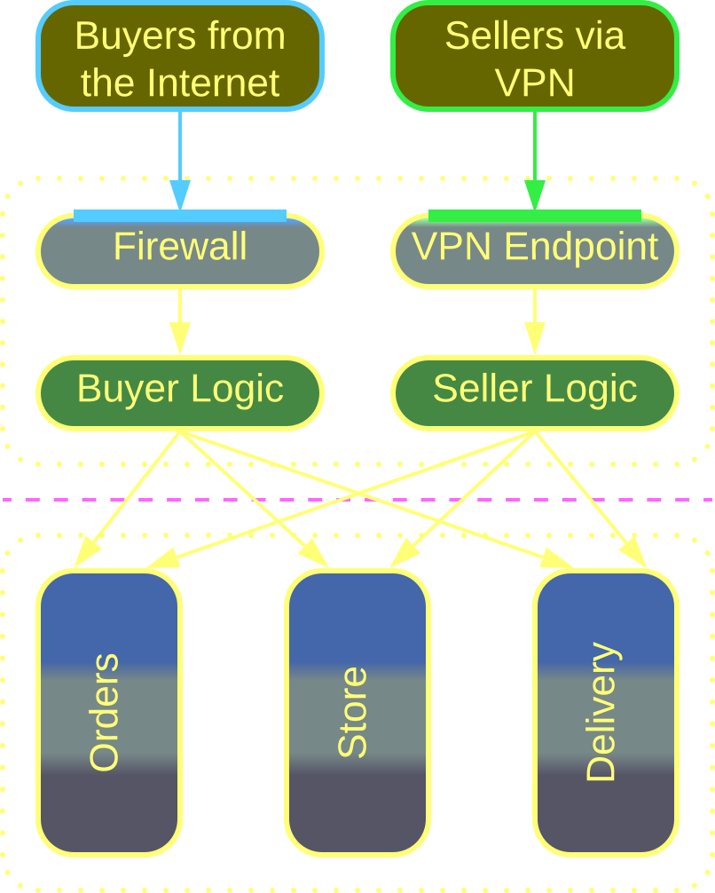
BFF – variants
When the clients differ in both protocol or security, and their workflows, Proxy + Orchestrator pairs are used.
This also allows for reusing Proxies and/or Orchestrators in different combinations.
Proxy + Orchestrator pairs

Slide 28
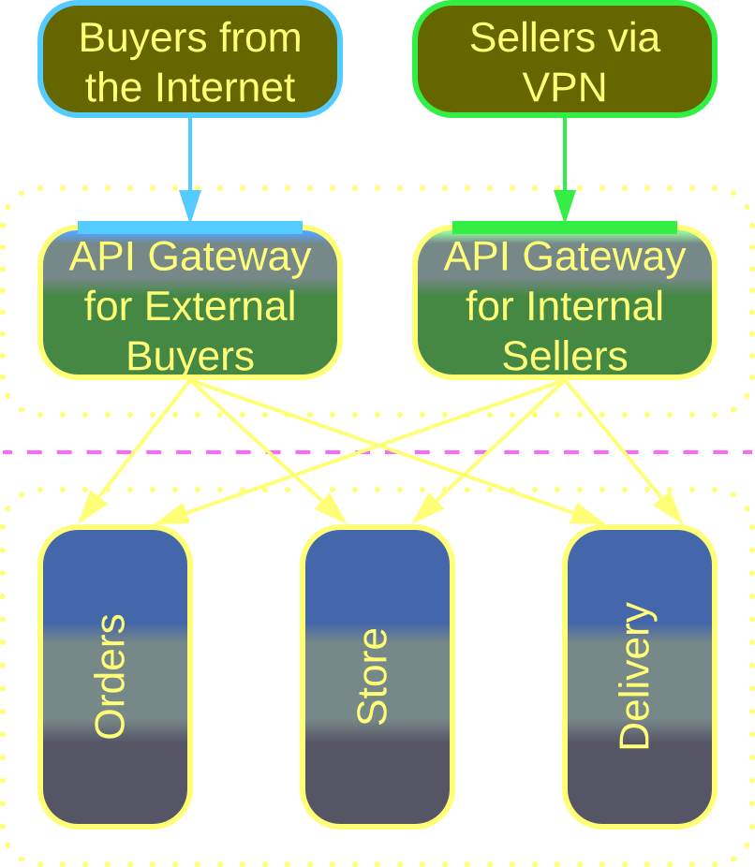
BFF – variants
An API Gateway implements aspects of both a Proxy and Orchestrator. Therefore it can be used as a more convenient alternative to a Proxy + Orchestrator pair.
API Gateways

Slide 29
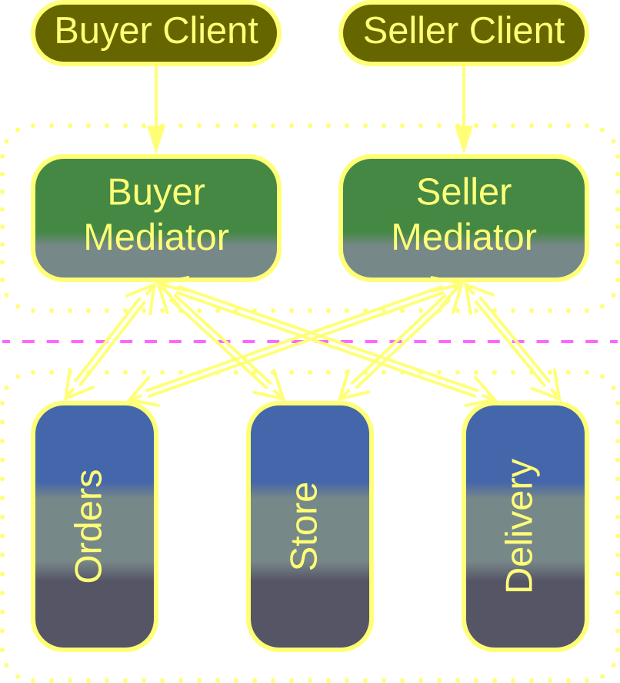
BFF – variants
An Event Mediator is an orchestrating Middleware. There are reports of using an Event Mediator per kind of system’s clients to achieve the following benefits:
Smaller and more cohesive orchestration logic for each kind of client.
If one Event Mediator malfunctions, the system remains available to other kinds of clients.
Event Mediators

Slide 30
Service-Oriented Architecture
Each layer is made of services

Slide 31
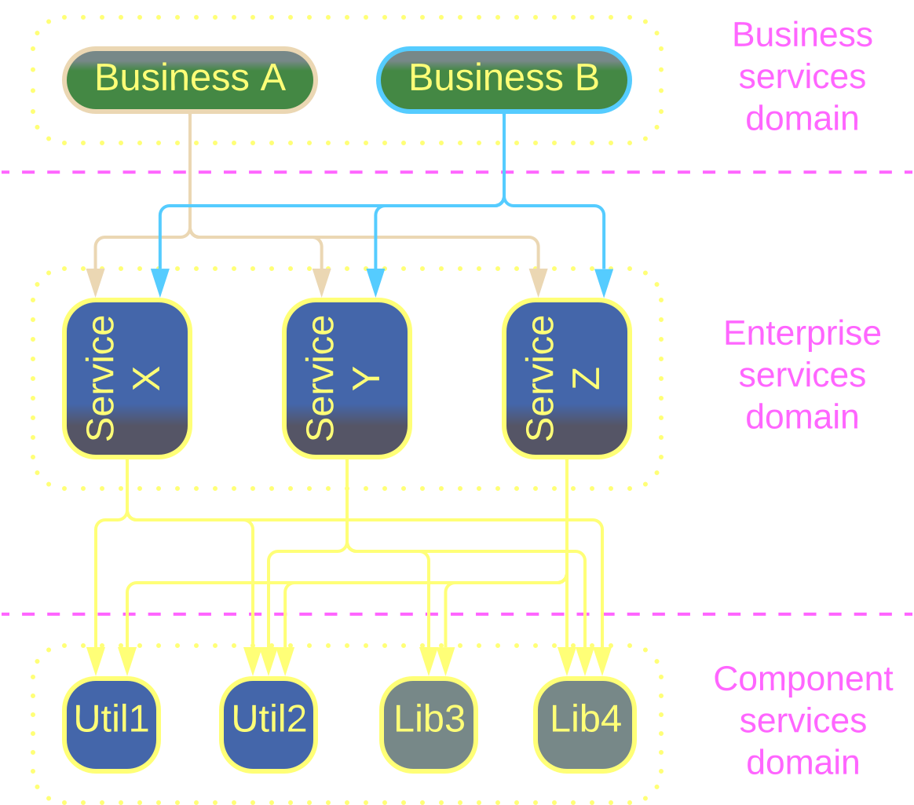
SOA – overview
Service-Oriented Architecture (SOA) first splits a system into Layers, then divides each layer into Services. This is similar to how OOP/OOD treats a complex project.
The resulting architecture addresses the complexity of the domain, but is itself quite complicated.
Service-Oriented Architecture
SOA suits huge projects, often with heterogeneous hardware.
But don’t expect fast-paced development or low latency.

Slide 32
SOA – trade-offs
Supports huge codebases with many development teams and technologies
Provides fine-grained scalability and deployment to dedicated hardware
The teams are interdependent, which slows down development
The excessive distribution makes the system slow, fragile, and hard to debug
The system is hard to maintain or test because it contains many tightly interacting components

Slide 33
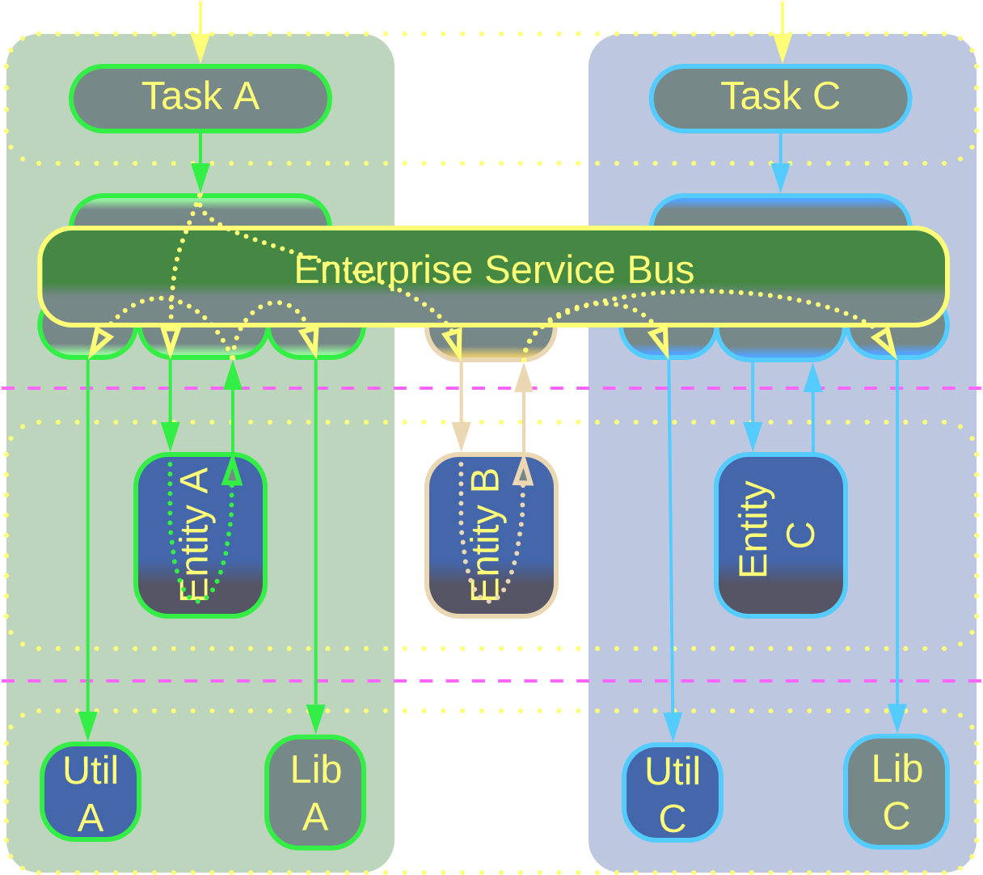
SOA – examples
Enterprises used to enlarge by acquiring smaller companies, each with its own homegrown software system that had to be integrated into the enterprise’s architecture.
The integration was mediated by an Enterprise Service Bus (ESB) responsible for both protocol translation and orchestration.
However, the resulting complexity of the ESB made everyone hate it.
Enterprise SOA

Slide 34
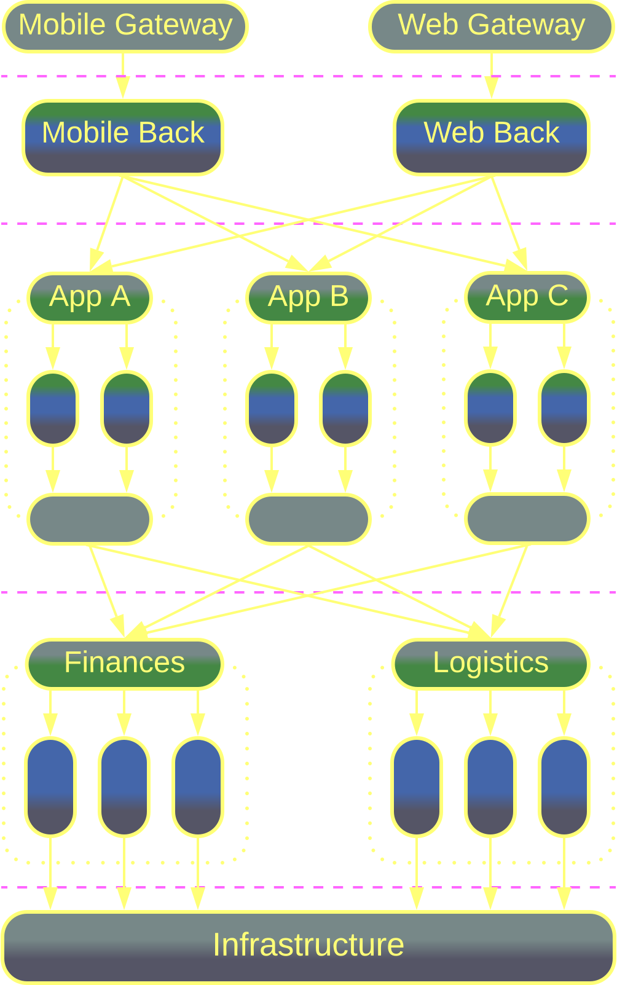
SOA – examples
Domain-Oriented Microservice Architecture (DOMA) is made up of Cells (domains, groups of related services) instead of plain services. It relies on Plugins for cross-domain customization.
DOMA seems to be a flexible real-world architecture suitable for huge projects.
Domain-Oriented Microservice Architecture

Slide 35
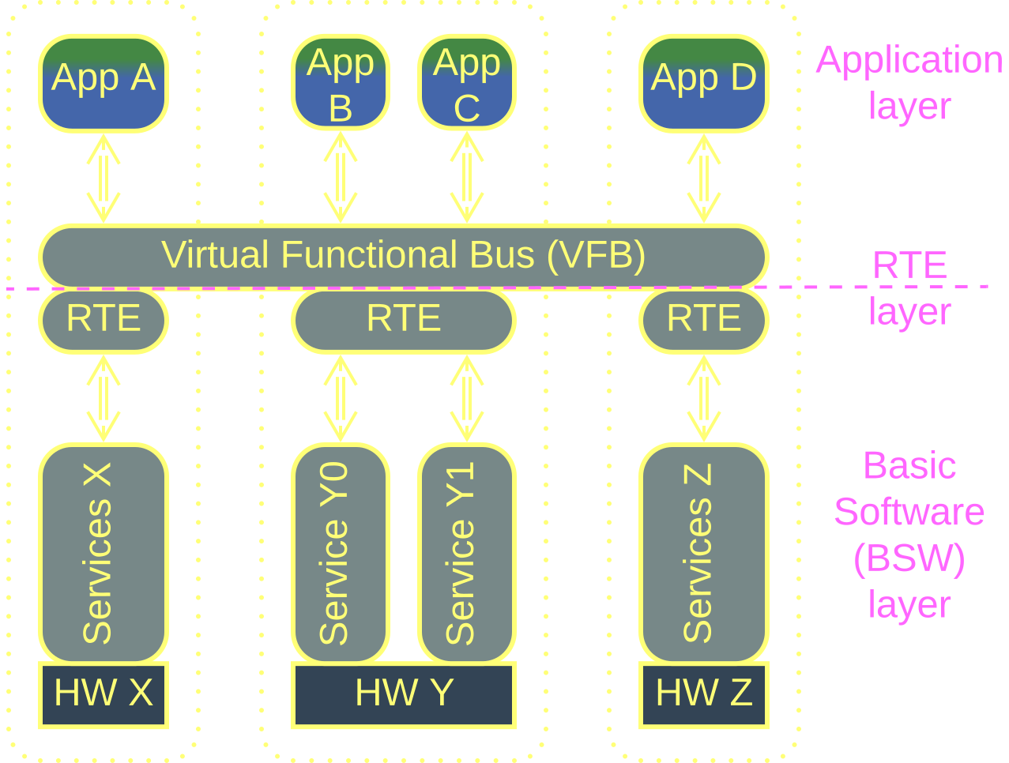
SOA – examples
AUTOSAR Classic from the automotive industry is marketed as a SOA (with its Virtual Function Bus matching ESB) but, on closer inspection, it looks like a Microkernel.
Automotive SOA

Slide 36
Hierarchy
A recursive structure

Slide 37
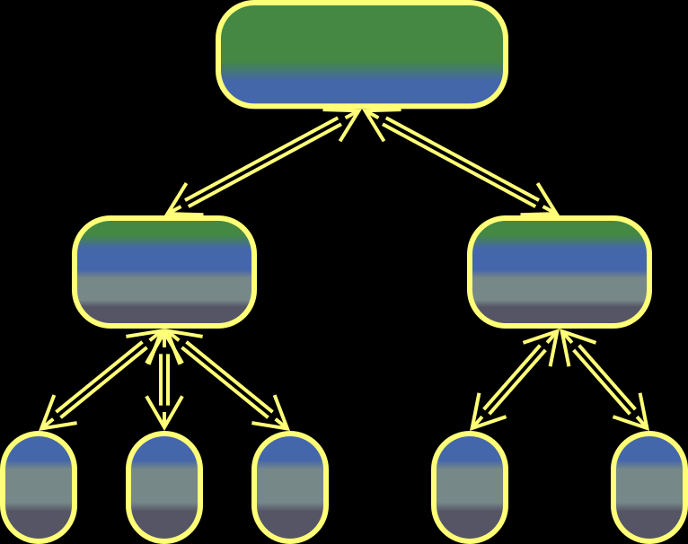
Hierarchy – overview
Hierarchy distributes complexity over a tree-like structure. It is straightforward, convenient, and agile, but few domains are truly hierarchical.
A Hierarchy can be built:
Top-Down (Orchestrator of Orchestrators)
Bottom-Up (Bus of Buses)
In-Depth (Cell-Based Architecture)
Hierarchy
Hierarchy shines with large projects and/or physical devices (IoT).
Making a good hierarchical decomposition may be hard or impossible.

Slide 38
Hierarchy – trade-offs
It’s good in decoupling logic
Multiple development teams are supported
Low-level components are easy to add or replace
The system is quite fault-tolerant as its parts may act independently
System-wide use cases are slow and hard to debug
Hierarchy has high operational complexity
It also requires much planning or trial and error to discover good interfaces

Slide 39
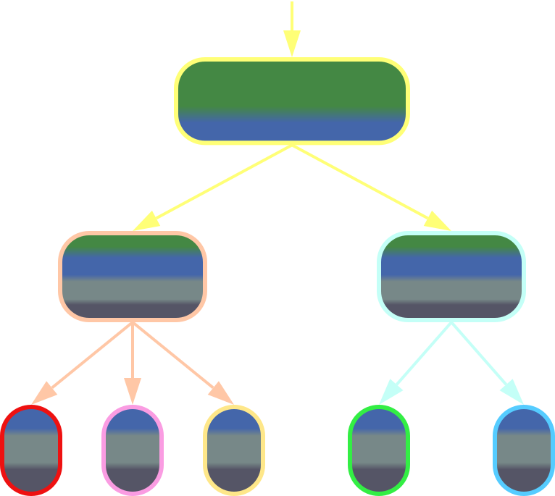
Hierarchy – variants
A Top-Down Hierarchy (Orchestrator of Orchestrators) builds a tree whose root deals with high-level commands or notifications while its leaves are responsible for concrete actions.
Examples include:
Product filters in web marketplaces.
Automation of industrial complexes (IIoT).
Hierarchical UIs (PAC and HMVC).
Top-Down Hierarchy

Slide 40
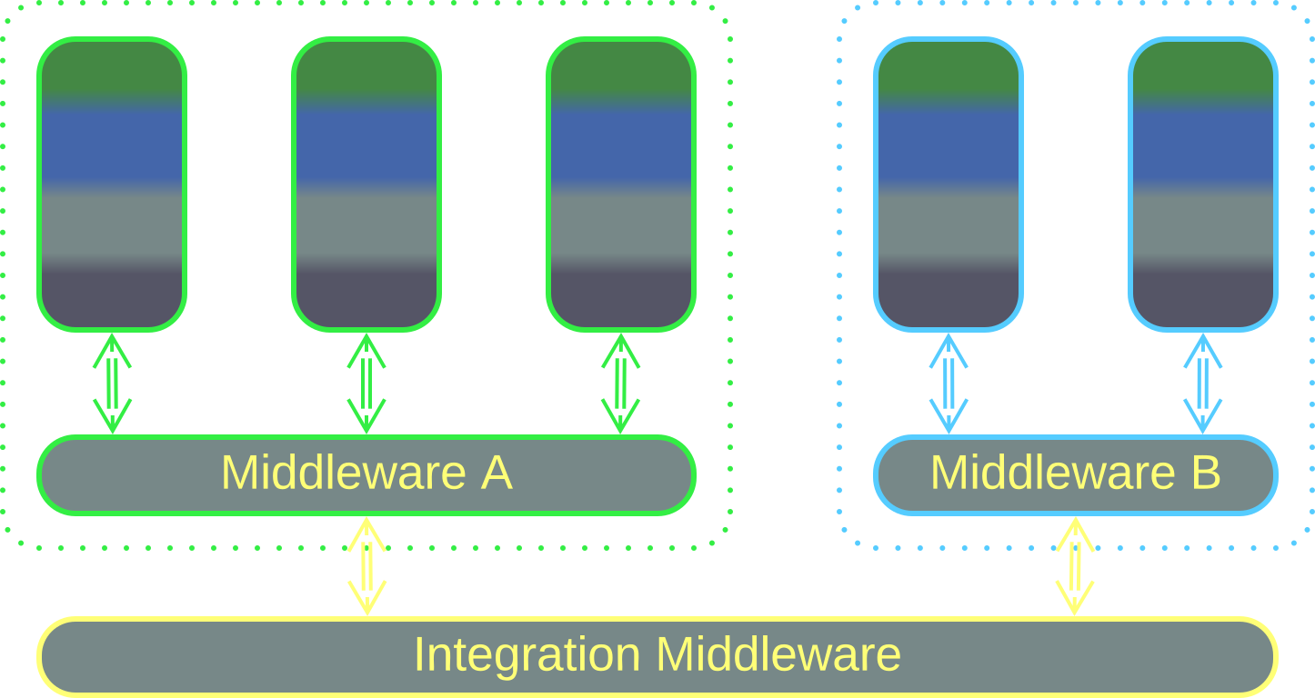
Hierarchy – variants
A Bottom-Up Hierarchy (Bus of Buses) interconnects several networks that differ in their internal protocols.
This is what the Internet is.
Bottom-Up Hierarchy

Slide 41
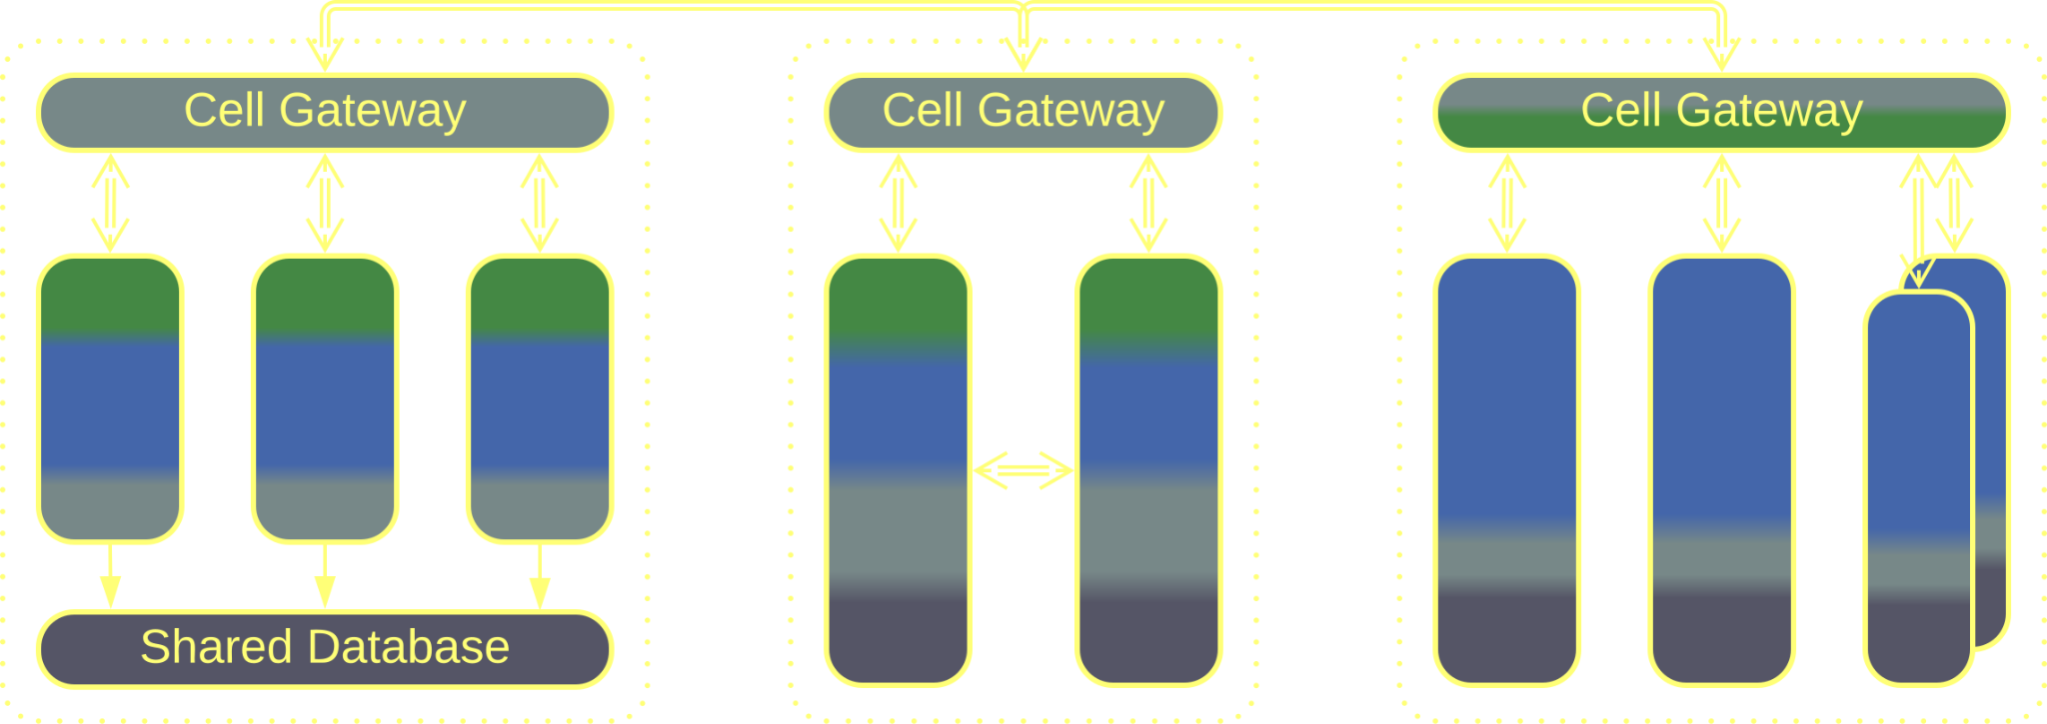
Hierarchy – variants
An In-Depth Hierarchy relies on a recursive subdivision of elements. A common example is the WSO2 definition of a Cell that is a subsystem made of services which itself takes the place of a single service in a larger system:
Cell-Based Architecture is a single layer of Cells.
Domain-Oriented Microservice Architecture is a SOA made of Cells.
In-Depth Hierarchy, Cell-Based Architecture

Slide 42
Conclusion

Slide 43
Subdividing a component
If a component conjoins loosely coupled segments, subdividing it may:
Yield smaller and better structured code thanks to the separation of concerns.
Improve performance through the careful selection of technologies.
Improve fault tolerance if the newly created parts of the system may act independently.
However, it also:
Increases operational complexity and latency.
Makes sharing code inconvenient.

Slide 44
Links
This was a brief summary of part 4 of Architectural Metapatterns:
– read it online at metapatterns.io
– download the eBook from leanpub.com/metapatterns
The diagrams and the ODT source file are available under the CC BY license.
If you like this book, please tell your friends about it.
I have no way to promote it on my own.

